Slide 1
Time Series Analysis and Forecasting

Slide 2
Introduction to Time Series Analysis
A time-series is a set of observations on a quantitative variable collected over time.
Examples
  Dow Jones Industrial Averages
  Historical data on sales, inventory, customer counts, interest rates, costs, etc
Businesses are often very interested in forecasting time series variables.
Often, independent variables are not available to build a regression model of a time series variable.
In time series analysis, we analyze the past behavior of a variable in order to predict its future behavior.

Slide 3
Methods used in Forecasting
Regression Analysis
Time Series Analysis (TSA)
  A statistical technique that uses time-series data for explaining the past or forecasting future events.
  The prediction is a function of time (days, months, years, etc.)
  No causal variable; examine past behavior of a variable and and attempt to predict future behavior

Slide 4
Components of TSA
Time Frame (How far can we predict?)
  short-term (1 - 2 periods)
  medium-term (5 - 10 periods)
  long-term (12+ periods)
  No line of demarcation
Trend
  Gradual, long-term movement (up or down) of demand.
  Easiest to detect

Slide 5
Components of TSA (Cont.)
Cycle
  An up-and-down repetitive movement in demand.
  repeats itself over a long period of time
Seasonal Variation
  An up-and-down repetitive movement within a trend occurring periodically.
  Often weather related but could be daily or weekly occurrence
Random Variations
  Erratic movements that are not predictable because they do not follow a pattern

Slide 6
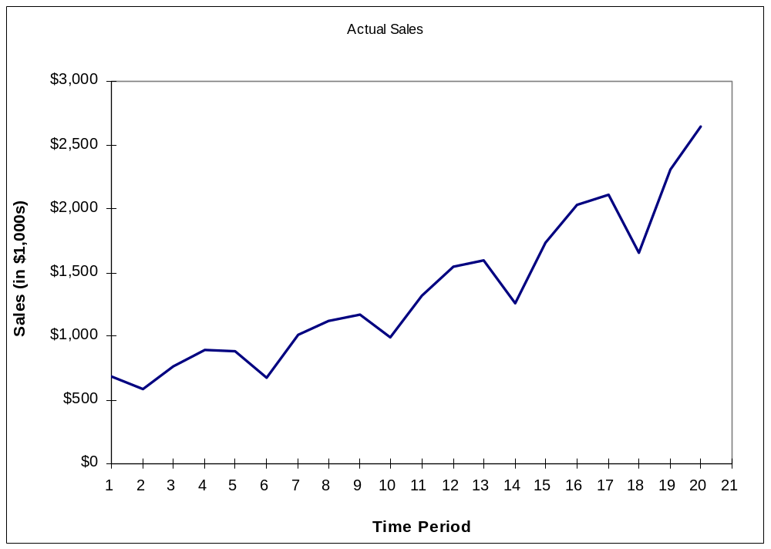
Time Series Plot

Slide 7
Components of TSA (Cont.)
Difficult to forecast demand because...
  There are no causal variables
  The components (trend, seasonality, cycles, and random variation) cannot always be easily or accurately identified

Slide 8
Some Time Series Terms
Stationary Data - a time series variable exhibiting no significant upward or downward trend over time.
Nonstationary Data - a time series variable exhibiting a significant upward or downward trend over time.
Seasonal Data - a time series variable exhibiting a repeating patterns at regular intervals over time.

Slide 9
Approaching Time Series Analysis
There are many, many different time series techniques.
It is usually impossible to know which technique will be best for a particular data set.
It is customary to try out several different techniques and select the one that seems to work best.
To be an effective time series modeler, you need to keep several time series techniques in your “tool box.”

Slide 10
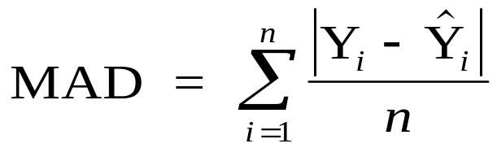
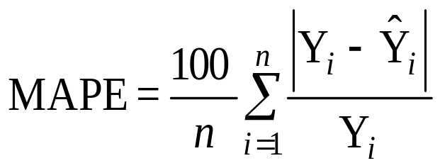
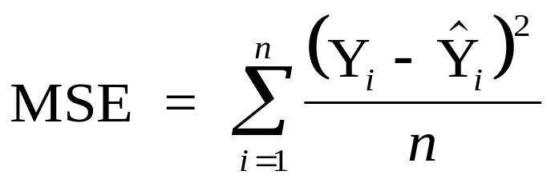
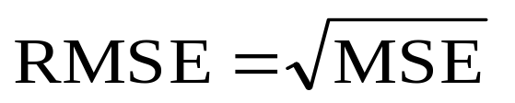
Measuring Accuracy
We need a way to compare different time series techniques for a given data set.
Four common techniques are the:
  mean absolute deviation,
  mean absolute percent error,
  the mean square error,
  root mean square error.
We will focus on MSE.

Slide 11
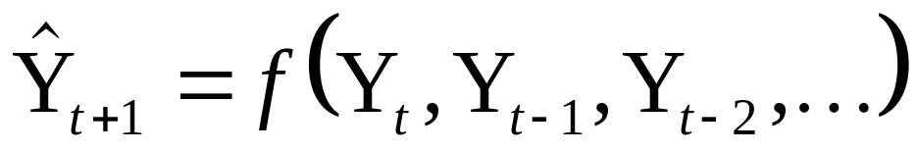
Extrapolation Models
Extrapolation models try to account for the past behavior of a time series variable in an effort to predict the future behavior of the variable.

Slide 12
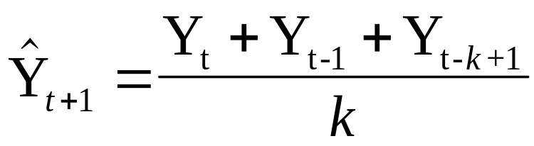
Moving Averages
No general method exists for determining k.
We must try out several k values to see what works best.

Slide 13
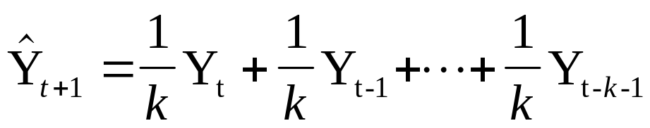
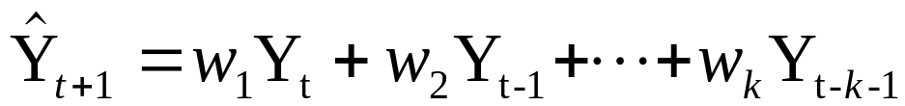
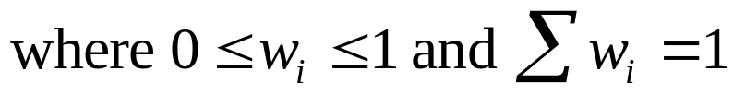
Weighted Moving Average
The moving average technique assigns equal weight to all previous observations
The weighted moving average technique allows for different weights to be assigned to previous observations.
We must determine values for k and the w_{i}

Slide 14
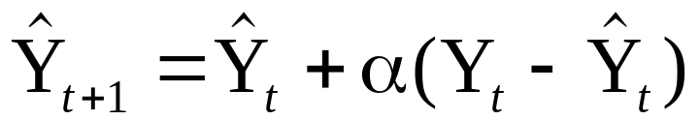

Exponential Smoothing
It can be shown that the above equation is equivalent to:

Slide 15
Seasonality
Seasonality is a regular, repeating pattern in time series data.
May be additive or multiplicative in nature...

Slide 16
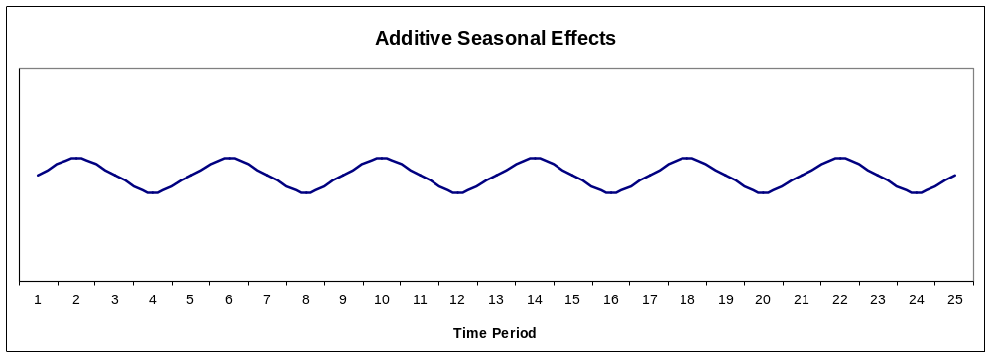
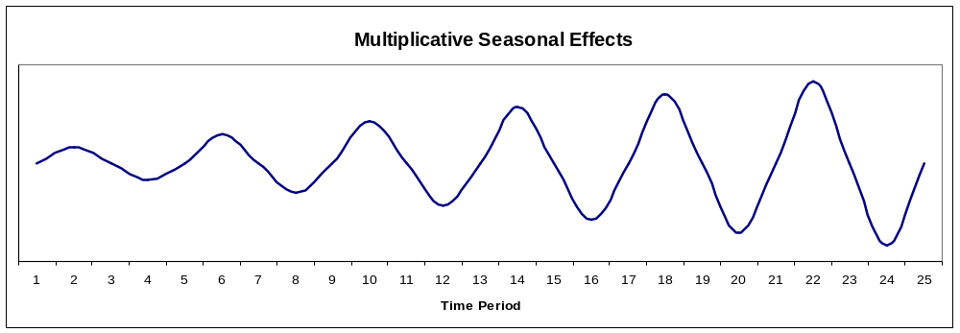
Stationary Seasonal Effects

Slide 17
Trend Models
Trend is the long-term sweep or general direction of movement in a time series.
We’ll now consider some nonstationary time series techniques that are appropriate for data exhibiting upward or downward trends.

Slide 18
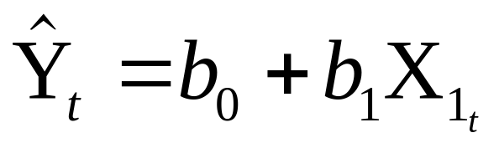
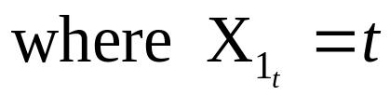

The Linear Trend Model
For example:

Slide 19
The TREND() Function
TREND(Y-range, X-range, X-value for prediction)
where:
Y-range is the spreadsheet range containing the dependent Y variable,
X-range is the spreadsheet range containing the independent X variable(s),
X-value for prediction is a cell (or cells) containing the values for the independent X variable(s) for which we want an estimated value of Y.
Note: The TREND( ) function is dynamically updated whenever any inputs to the function change. However, it does not provide the statistical information provided by the regression tool. It is best two use these two different approaches to doing regression in conjunction with one another.

Slide 20
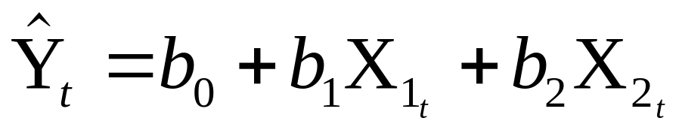
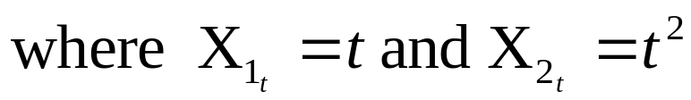
The Quadratic Trend Model

Slide 21
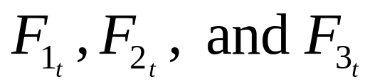
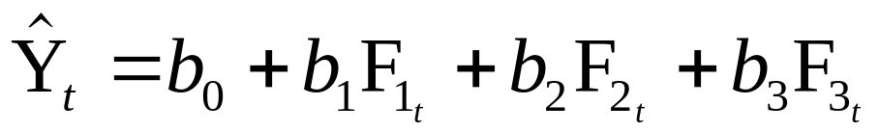
Combining Forecasts
It is also possible to combine forecasts to create a composite forecast.
Suppose we used three different forecasting methods on a given data set.
Denote the predicted value of time period t using each method as follows:
We could create a composite forecast as follows:

